Slide 1
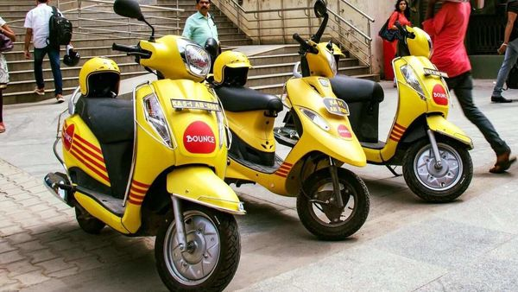
CAPSTONE PROJECT Bike Sharing Demand Prediction
TEAM MEMBERS
Aditya Tadas
Nikhil Machave
Aishwarya Methe

Slide 2

CONTENT
BUSINESS UNDERSTANDING
DATA SUMMARY
FEATURE ANALYSIS
FEATURE ENGINEERING
EXPLORATORY DATA ANALYSIS
DATA CLEANING
DATA PREPROCESSING
IMPLIMENTING ALGORITHEMS
CHALLENGES
CONCLUSIONS

Slide 3
BUSINESS UNDERSTANDING
Bike rentals services are often use by the peoples now a days hence this business becomes more popular having relatively cheaper rates also ease to pick up and drop at own convenience is one of the best thing to make business popular and profitable.
It is mostly use by the people having no vehicles and having schedule to travel daily for there work and other related things.
Bike rentals services are also often use for vacations day to travel for a long distance also minimize time and avoid congested public transport .
For that reasons it is essential to have supply of no. of bikes at different locations to fulfill the demand.
Our goal for these project is to predict supply of bike count according to certain conditions to meet the demand of the bikes for business Profitability.

Slide 4
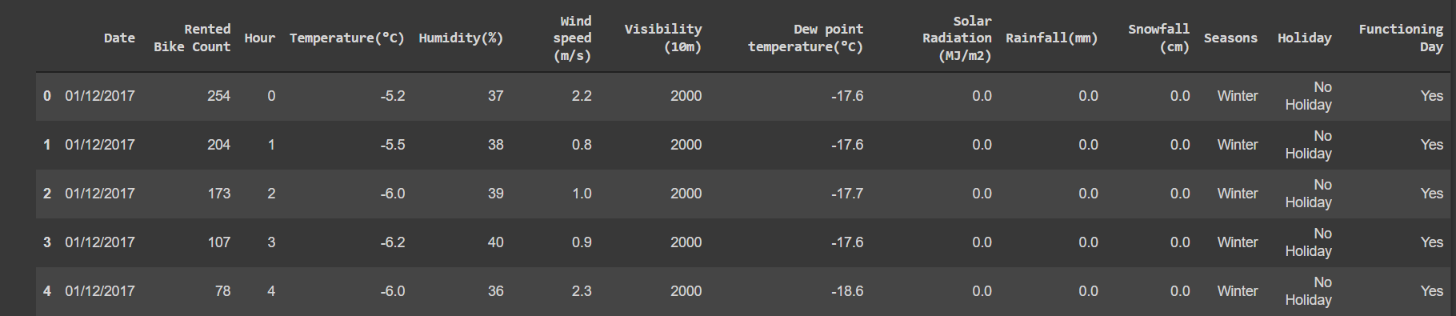
DATA SUMMARY
Here We have Data Summary of our data Which shoes that these dataset contains 8760 Rows and 14 Columns.
Three Categorical Features ‘Seasons’, ’Holiday’, and ‘Functioning Day’.
One Date Time Feature “Date”.
Also we have some numerical variables such as Temperature ,Humidity, Wind Speed, Visibility, Solar Radiation, Rainfall, Snowfall which tells us how environmental codition affects Rental Bike Count.

Slide 5
Feature Analysis
Date : year-month-day
Rented Bike count - Count of bikes rented at each hour
Hour - Hour of he day
Temperature-Temperature in Celsius
Humidity - %
Wind speed - m/s
Visibility - 10m
Dew point temperature - Celsius
Solar radiation - MJ/m2
Rainfall - mm
Snowfall - cm
Seasons - Winter, Spring, Summer, Autumn
Holiday - Holiday/No holiday
Functional Day – No Func(Non Functional Hours), Fun(Functional hours)

Slide 6
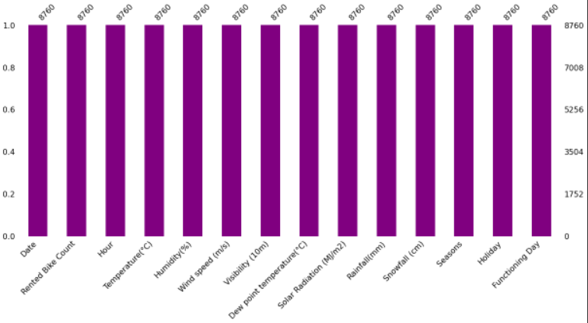
INSIGHTS FROM OUR DATASET
There are No missing values present in out dataset.
There are No duplicates value present in our dataset.
There are No Null values in out dataset.

Slide 7
FEATURE ENGINEERING
We convert Date column into three different column ‘year’, ’month, Weeekday.
We replace month number in words for understanding.
'Jan','Feb','Mar','Apr','May','Jun','Jul','Aug','Sep','Oct','Nov','Dec'
We replace Day of week into in to numbers
'Mon’, 'Tues’, 'Wed’, 'Thu’, 'Fri’, 'Sat’, 'Sun'

Slide 8
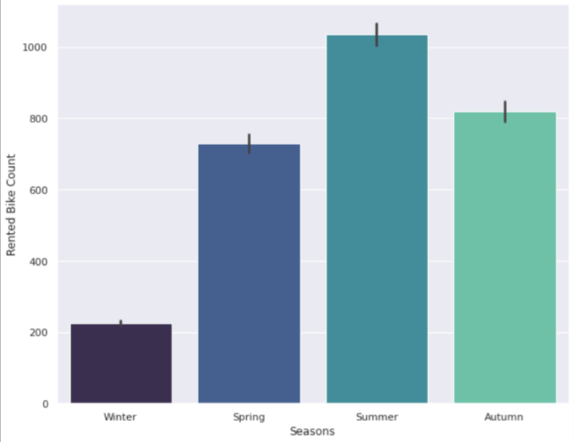
ANALYSIS OF SEASONS VARIABLE
Above Bar plot shows that seasons wise distribution of rented bike counts.
We can see that rented bike counts are maximum in summer season and it is minimum in winter season.
The spring and Autumn season has same rented bike counts.

Slide 9
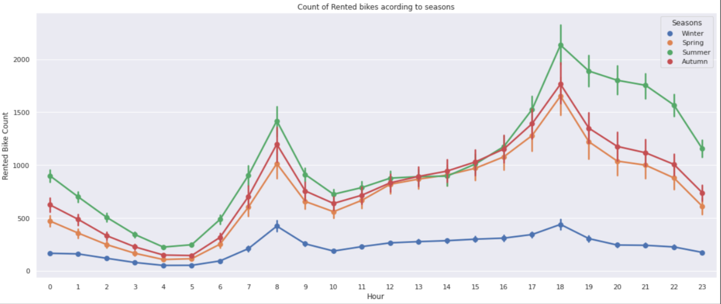
ANALYSIS OF SEASONS VARIABLE WITH RESPECT TO HOUR VARIABLE
Above line plot shows rented bike counts in seasons with respect to hours.
From the above visualization we can clearly see that maximum rented bike counts have a high fluctuation in between 5 am to 8 am also in between 5 pm to 7 pm so most people have rented the bikes in between these two time intervals.

Slide 10
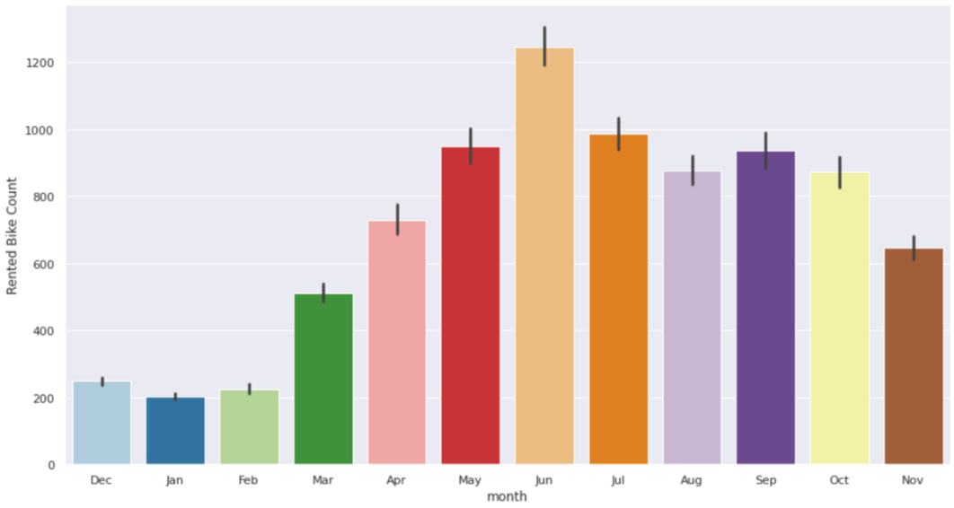
ANALYSIS OF MONTH VARIABLE
In the above Bar plot as we can see that maximum bikes are rented in May , June , July months.
Intermediate bikes are rented in August , September and Octomber months.
And there are comparatively minimum bikes are rented in December , January , February and November Months.

Slide 11
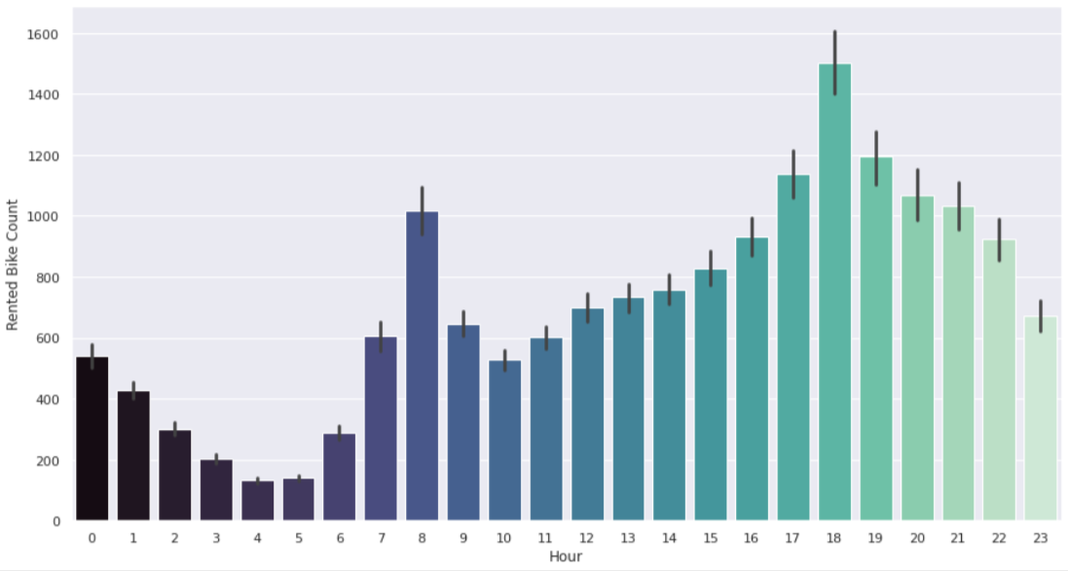
ANALYSIS OF HOUR VARIABLE
As we can see in the following bar plot more bikes are rented in the time interval of 7 am to 9 am and 5 pm to 8 pm probably the people rented more bike to reach at office and to come to the residual place from the office
Also we have minimum bikes are rented in between 1 am to 5 am .

Slide 12
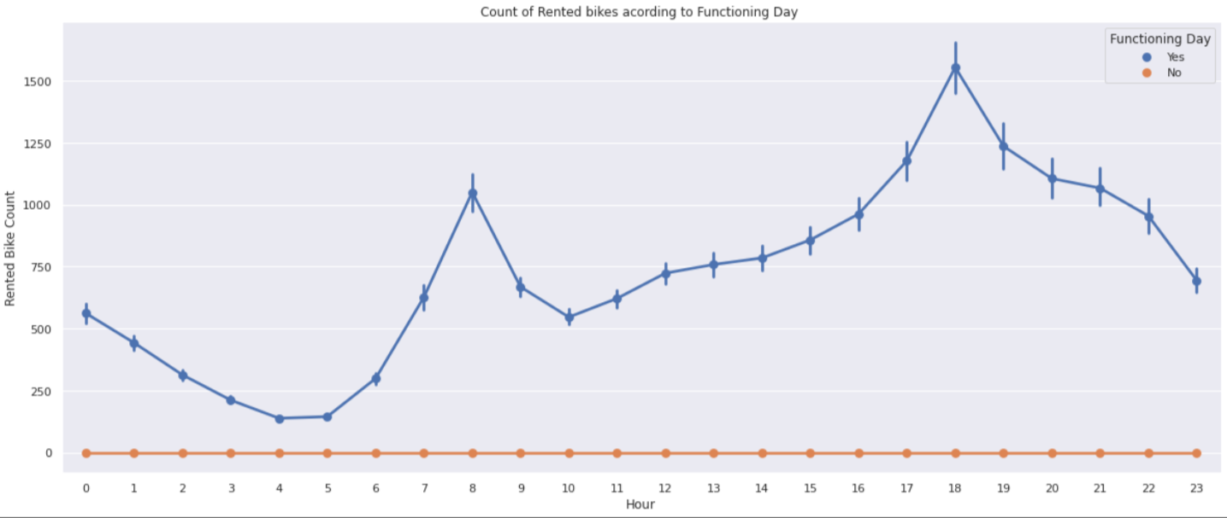
ANALYSIS OF FUNCTION DAY VARIABLE WITH RESPECT TO HOUR
As we can see in the above line plot when there is no function day peoples are not prefer to rent bikes.
Though when there is a function day we can see the high pick in between 6 am to 9 am as well as in between 5 pm to 8 pm.

Slide 13
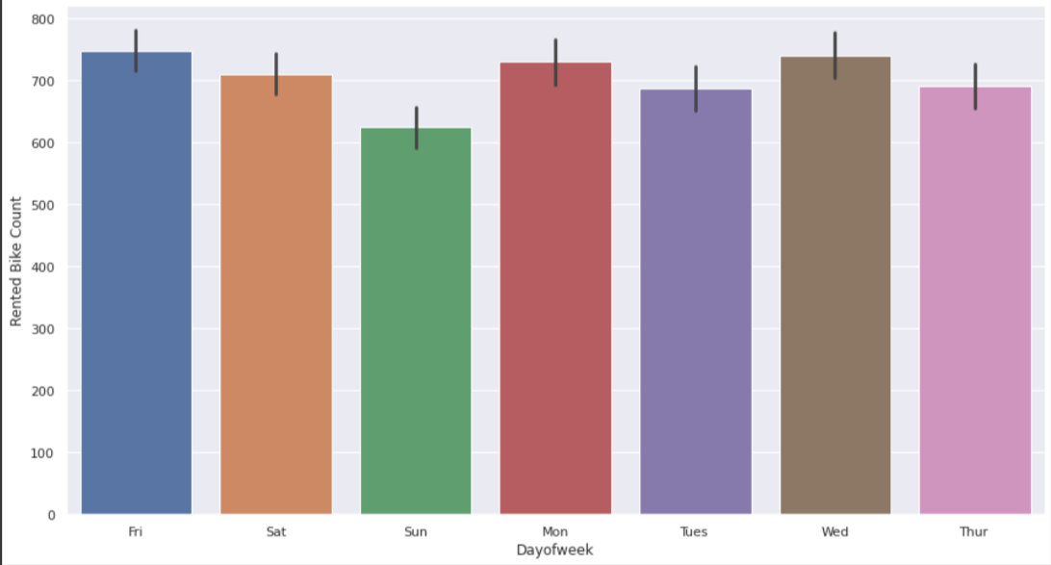
ANALYSIS OF DAY OF WEEK VARIABLE
As we can see in the following bar plot of day wise distribution of rented bike counts we can conclude that on the weekend day we have minimum bike rented as compared to weekday,

Slide 14
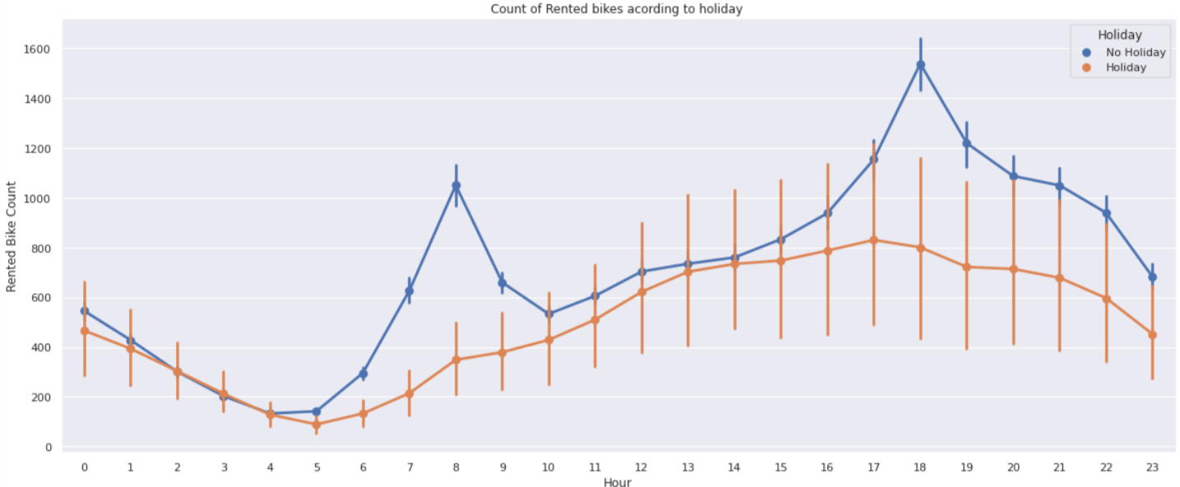
ANALYSIS OF HOLIDAY VARIABLE WITH RESPECT TO HOUR
In the following line plot we can see that when there is No Holiday peoples rented more bikes from 6 am to 9 am and 4 pm to 7 pm.
But when there is Holiday most number of peoples have rented bikes in between 11 am to 4 pm.

Slide 15
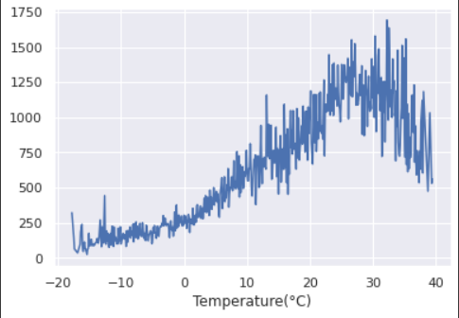
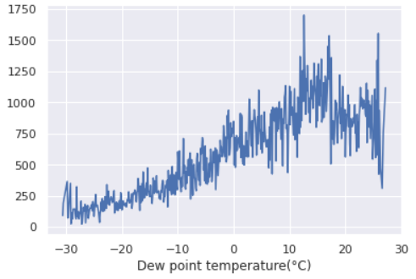
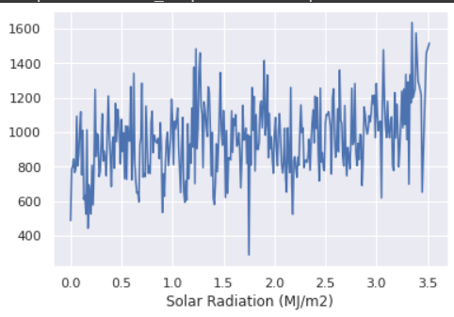
NUMERICAL VARIABLE VS RENTED BIKE COUNTS
As we can see that in the following graph No. of rented bike counts are gradually increase as the tempreture increase
when the temperature lies in between 25 to 35 peoples have rented more bikes so we can say that people prefer to rent a bikes when the temperature is normal.
From a graph of dew point temperature also number of rented bikes increases when the Dew point temperature increases
and the rented bike counts re high se we have a 10 to 20 celsius temperature so we can say that people prefers to rent
bikes when Dew point temperature is normal.
Also from the graph of solar radiation we can say that the amount of rented bikes is huge when there is solar radiation
the counter of rent is around 1000

Slide 16
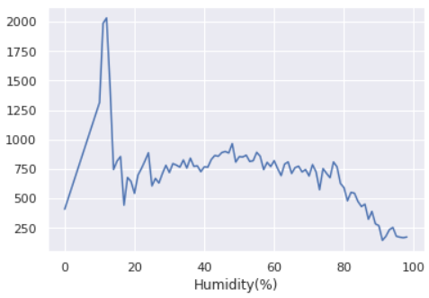
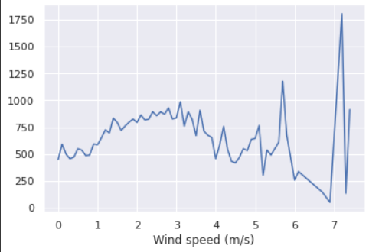
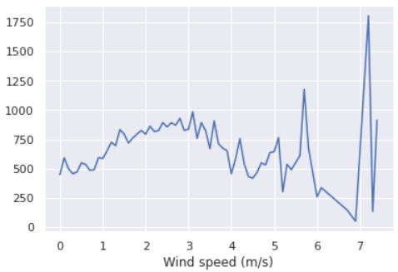
NUMERICAL VARIABLE VS RENTED BIKE COUNTS
Following graph of Humidity shows that when average humidity percentage is less 5 to 15 then most of the people rented bikes then as the average humidity percentage become increase number of rented bike count decrease therefore we can say that most of the people rented bikes when the humidity percentage is less.
Then we have Wind Speed graph it shows that when wind speed is about 5 to 6 then the number of rented bikes increase
Also when it becomes high upto 8 then we can see huge increase in number of rented bike counts therefore we can say that people prefer to rent a bike when the atmosphere is little windy.

Slide 17
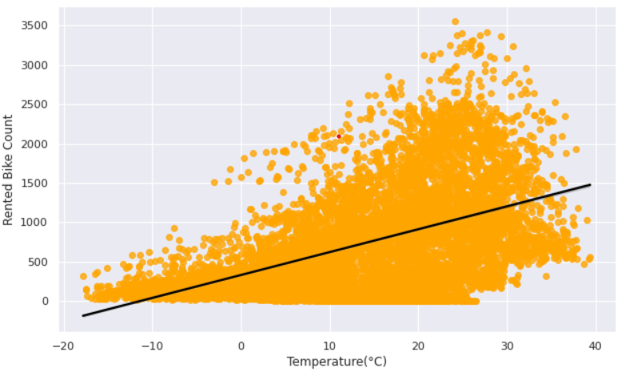
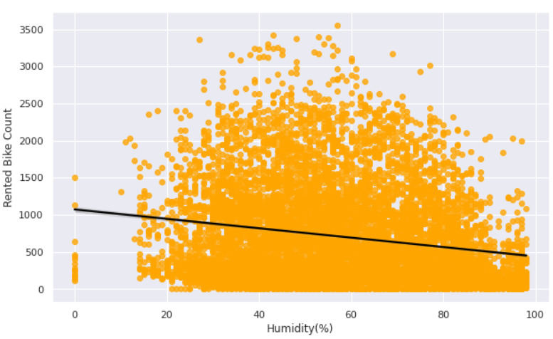
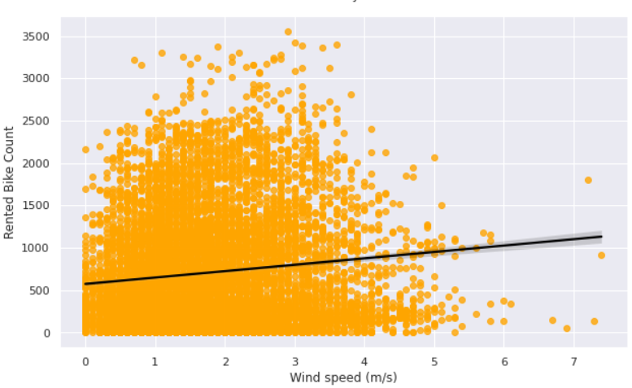
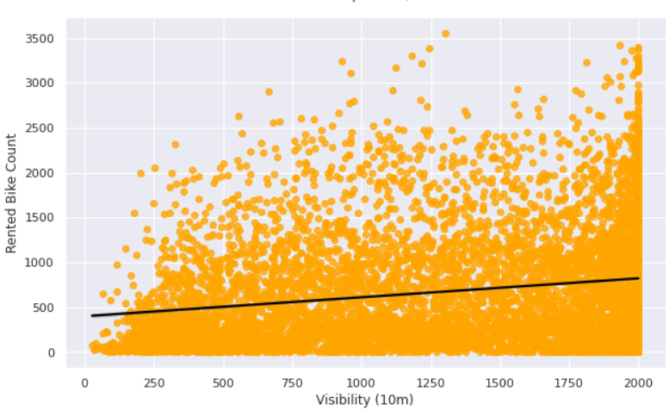

Slide 18
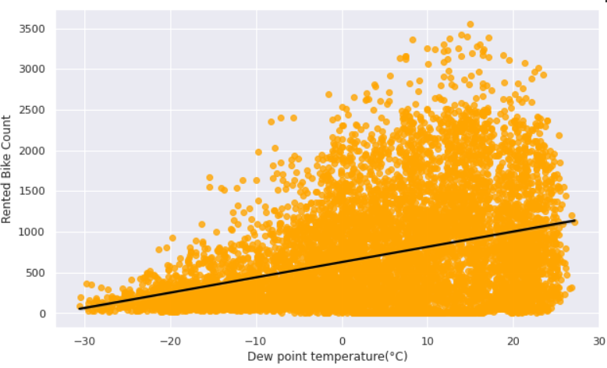
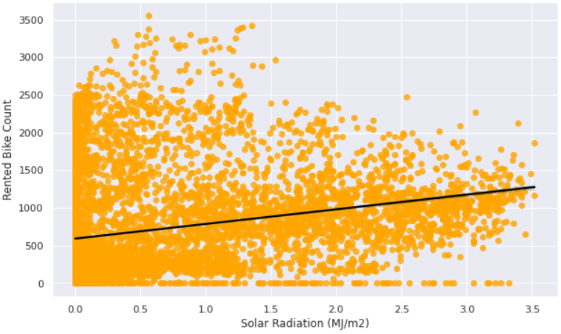
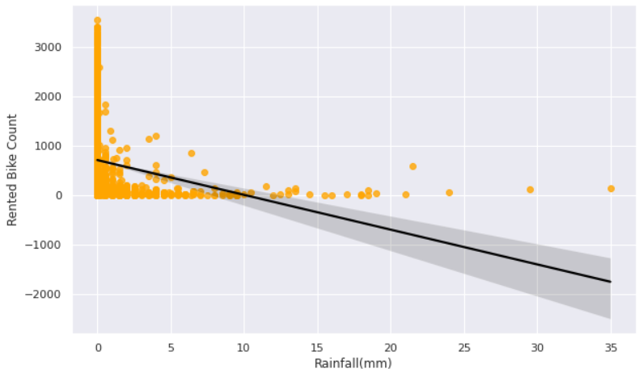
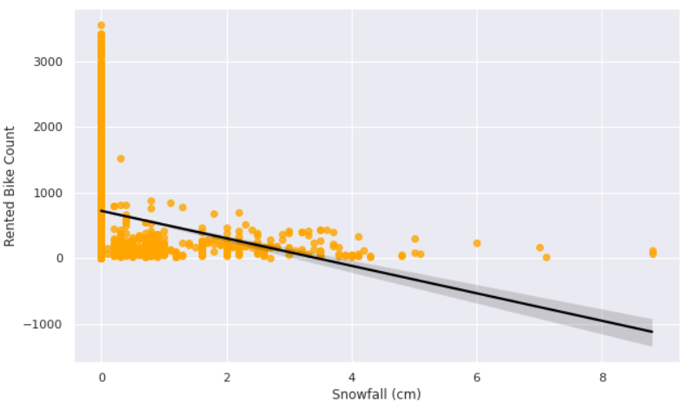

Slide 19
REGRESSION PLOT FOR NUMERICAL VARIABLES
From the above regression plots we can observe that numerical features i.e ‘Temperature’, ‘Wind Speed’, ‘Visibility’ , ‘Dew Point Temperature’ , ‘Solar Radiation’ having positive relation to the target
Variable.
Which means as these feature values are increase there will be a increase in Rented Bike counts.
Also there are some features having Negative relation to the target variables these features are ‘Rainfall’ , ‘Snow Fall’ , ‘Humidity’ as these features values are increase Rented Bikes count Decrease.

Slide 20
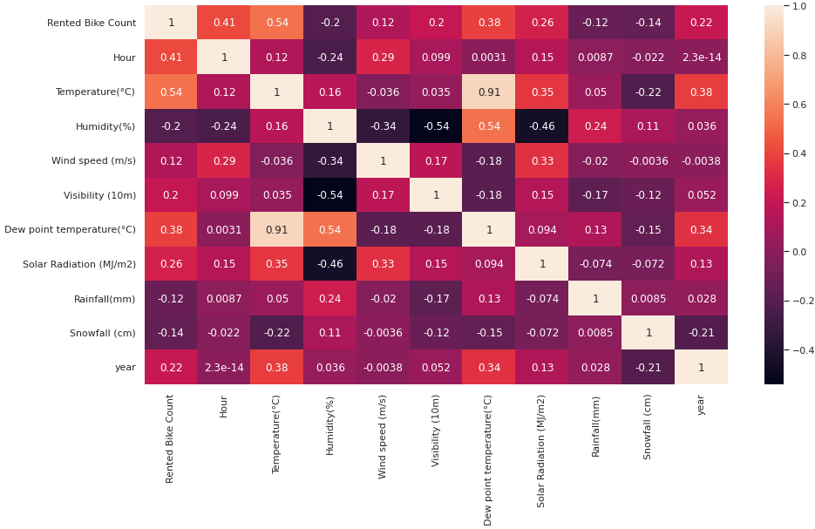
CORRELATION PLOT

Slide 21
Insights From Correlation Plot
Some features having high correlation with our target variable
‘Temperature’ , ‘Hour’ , ‘ Dew Point Temperature’ these features
more important while predicting rented bike counts.
Some features having very low correlation with rented bike counts
‘Rainfall’ , ‘Snow Fall’ .
‘Tempreture’ and ‘Dew Point Tempreture’ are the high correlated variables with each it has a correlation of 0.91 hence we need to drop one of these variable because It leads to acts like a duplicate while we are training our machine learning model.

Slide 22
MODEL BUILDING
LINEAR REGRESSION
LASSO REGRESSION
RIGDE REGRESSION
DECISION TREE REGRESSOR
GRADIENT BOSSTING REGRESSOR

Slide 23
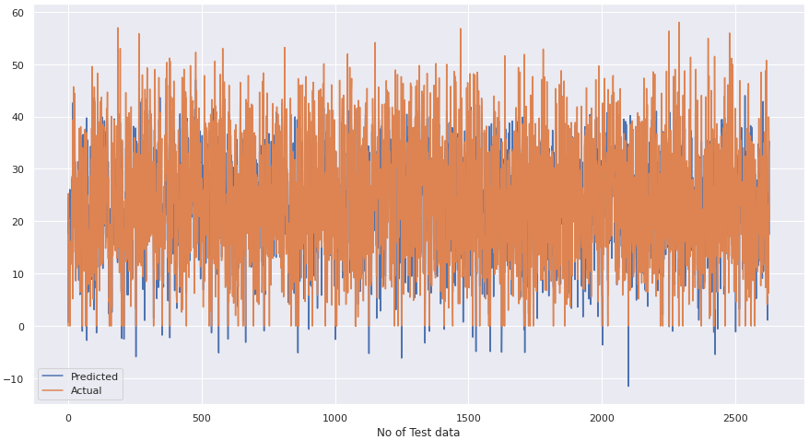
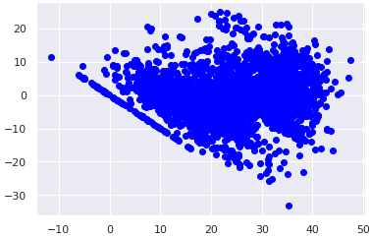
LINEAR REGRESSOR
R2 - 0.673931

Slide 24
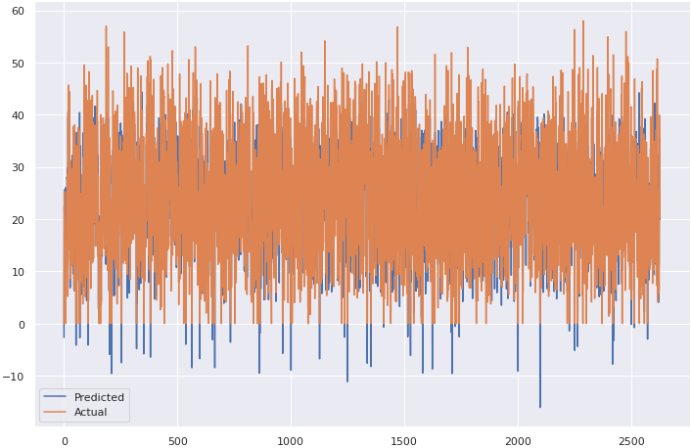
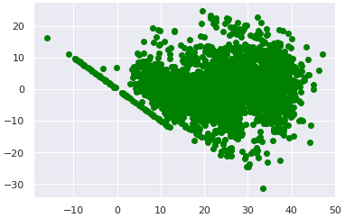
LASSO REGRESSOR
R2 - 0.674457
R2 - 0.673931

Slide 25

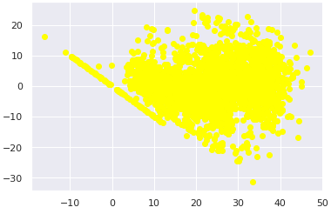
RIDGE REGRESSOR
R2 - 0.874781

Slide 26
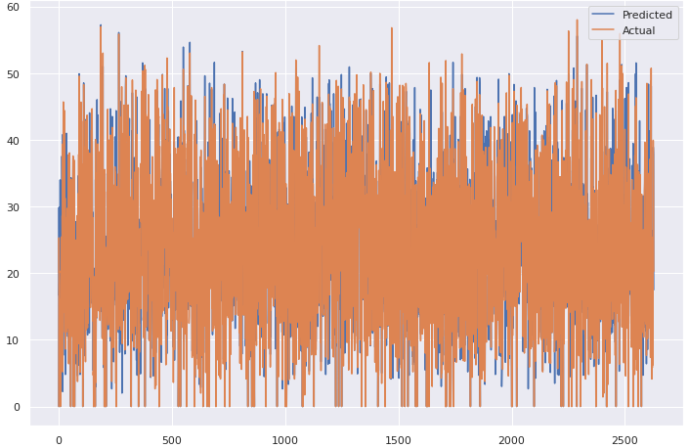
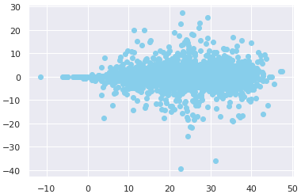
DECISION TREE REGRESSOR
R2 - 0.886139

Slide 27
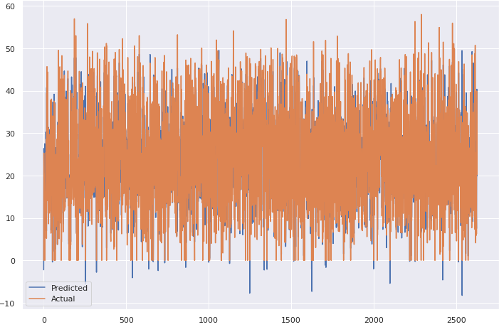
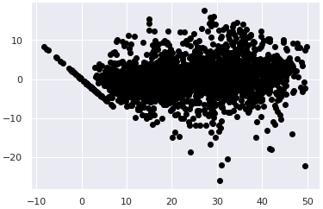
GRADIENT BOSTING REGRESSOR
R2 - 0.903222

Slide 28
REGRESSION MODELS AND ACCURACY
 | REGRESSION MODELS NAME | R2 -SCORE
0 | LINEAR REGRESSOR | 0.673931
1 | LASSO REGRESSOR | 0.674457
2 | RIDGE REGRESSOR | 0.874781
3 | DECISION TREE REGRESSOR | 0.886139
4 | GRADIENT BOOSTING REGRESSOR | 0.903222

Slide 29
CHALLENGES FACED
• 1. Pre-processing the data was one of the challenges we faced which includes removing highly correlated variables from the data so as to not hinder the performance of our regression model.
• 2. Exploring all the columns and calculating VIF for Multicollinearity was challenging because it might decrease the models performance.
• 3. Selecting the appropriate models to maximize the accuracy of our predictions was one of the challenges faced.

Slide 30
CONCLUSION
EDA:
Demand for bikes got higher when the temperature and hour values were more.
Demand was high for low values of Humidity and solar radiation.
Demand was high during springs and summer and autumn and very low during winters.
Maximum bikes were rented in the year 2018
Count of rented bikes is high during no holiday and functioning day especially during office time.

Slide 31
Model Fitting Conclusion
From above its clear that Gradient Boosting regressor (CV) model is the best model for this dataset.
Decision tree Regressor and Gradient Boosting Gridsearchcv gives the highest R2 score of 88% and 90% respectively
The most important features who had a major impact on the model predictions were; hour, temperature, Humidity, solar-radiation, and Winter.
The model performed well in this case but as the data is time dependent, values of temperature, wind-speed, solar radiation etc. will not always be consistent. Therefore, there will be scenarios where the model might not perform well. As Machine learning is an exponentially evolving field, we will have to be prepared for all contingencies and also keep checking our model from time to time

